Slide 1
Camera recognition (by gesture)
鎘鐳兒OuO

Slide 2
For what ?
Key point :
1 . Make taunting easier
2 . Enhance gaming experience

Slide 3
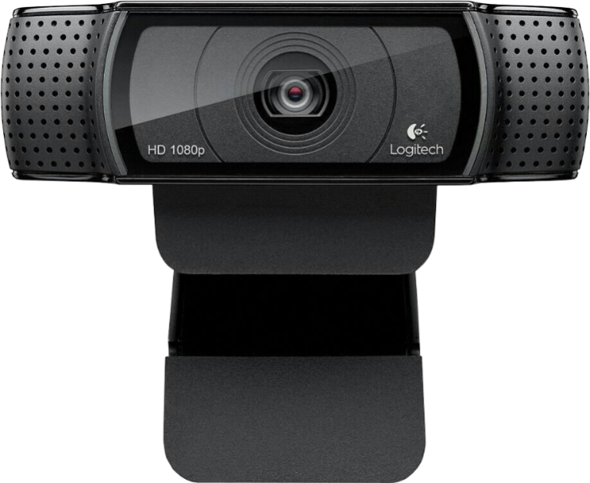
How to do ?
Hi I’m camera !
We use camera recognition instead of pressing any key to call out.

Slide 4
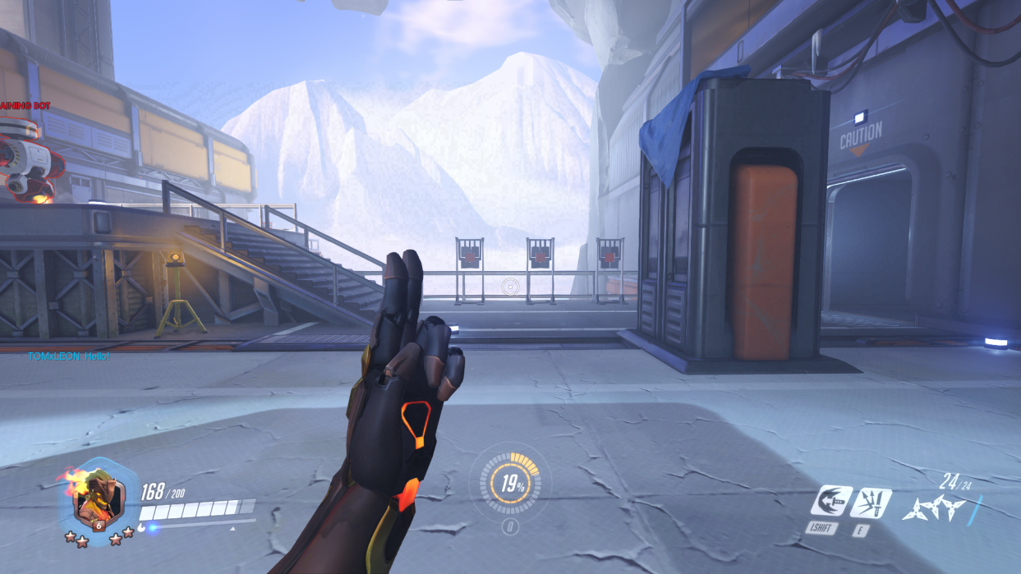
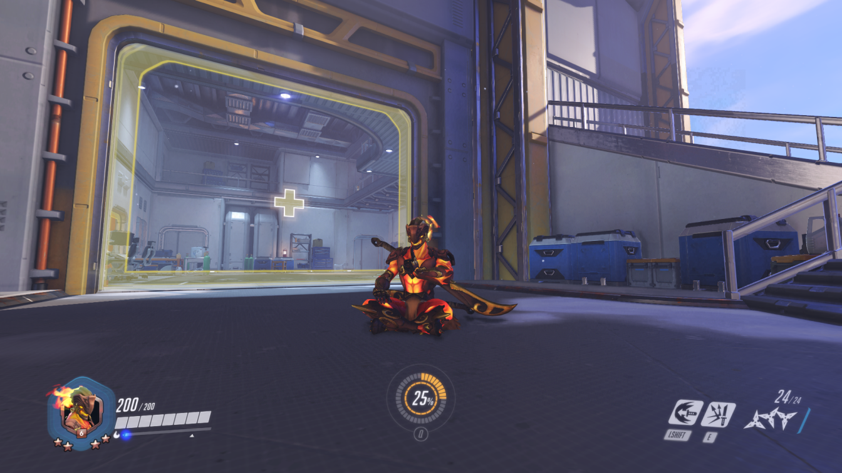
Common call out in games
e.g. Thumb up
e.g. Wave hand

Slide 5
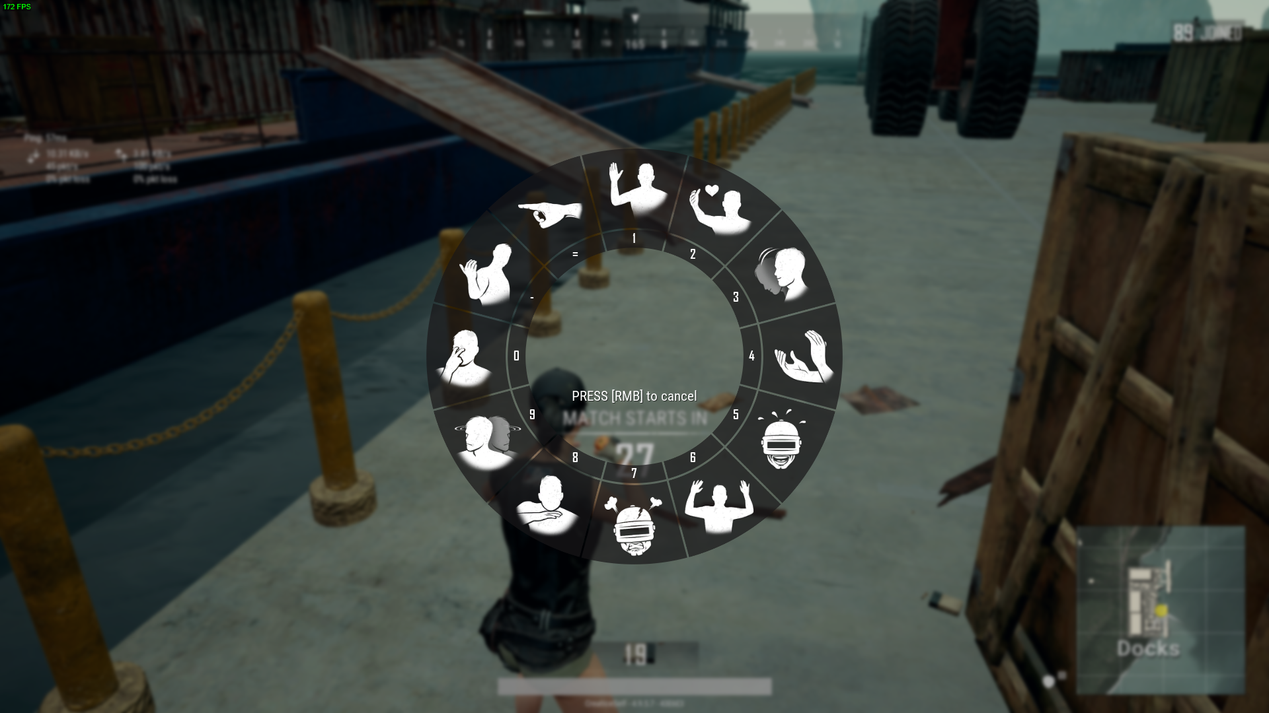
Taunts in games
Emotes in PUBG
We can use our emotes with hotkey

Slide 6
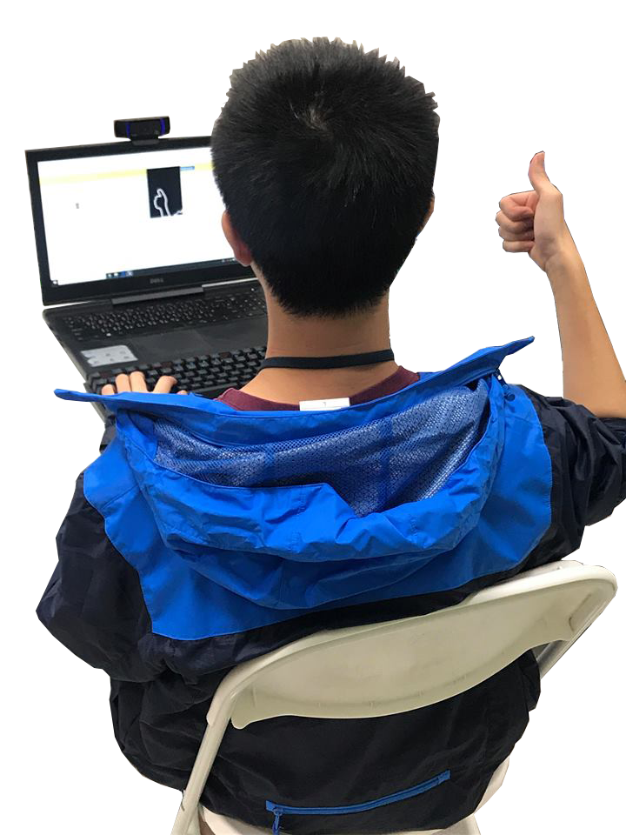
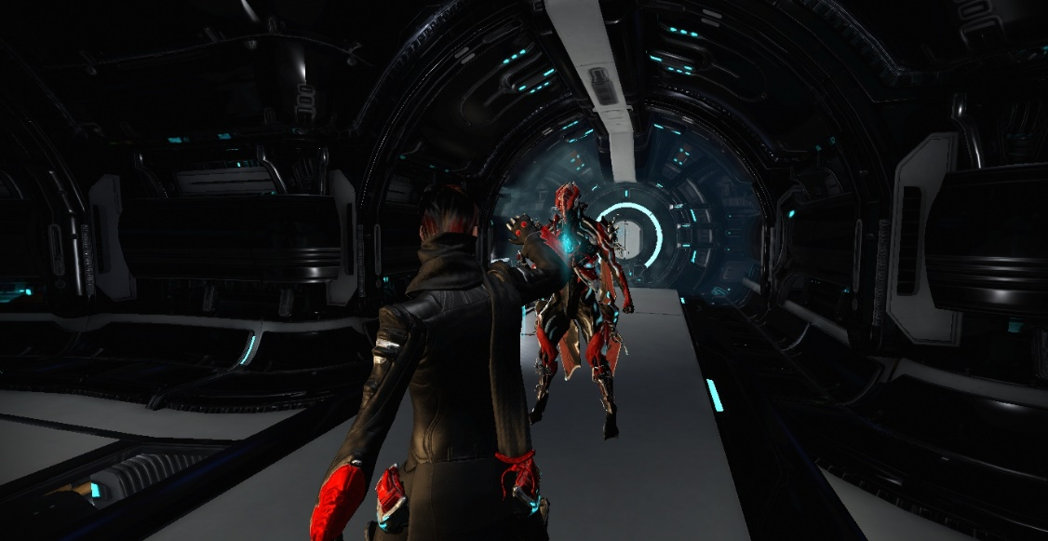
Objective
To convert our gestures into game emote

Slide 7
Procedure
Capture the scene of camera
Identify the gesture
Generate into the correct command

Slide 8
Obstacles
The gestures cannot be correctly identified
=> number of samples is not enough and makes it not
easy to identify
If the game doesn’t support hot key it may not work

Slide 9
Demo
Identifying the emote by the time duration

